Slide 1
Association Rule Mining
Apriori Algorithm

Slide 2
Basic Concepts: Frequent Patterns and Association Rules
Transaction-id | Items bought
10 | A, B, D
20 | A, C, D
30 | A, D, E
40 | B, E, F
50 | B, C, D, E, F
Itemset X = {x₁, …, x_{k}}
Find all the rules X → Y with minimum support and confidence
support, s, probability that a transaction contains X ∪ Y
confidence, c, conditional probability that a transaction having X also contains Y
Customer
buys both
Customer
buys diaper
Let sup_{min} = 50%, conf_{min} = 50%
Freq. Pat.: {A:3, B:3, D:4, E:3, AD:3}
Association rules:
A → D (60%, 100%)
D → A (60%, 75%)
Customer
buys beer

Slide 3
Association Rule Mining Task
Given a set of transactions T, the goal of association rule mining is to find all rules having
support ≥ minsup threshold
confidence ≥ minconf threshold
Brute-force approach:
List all possible association rules
Compute the support and confidence for each rule
Prune rules that fail the minsup and minconf thresholds
⇒ Computationally prohibitive!

Slide 4
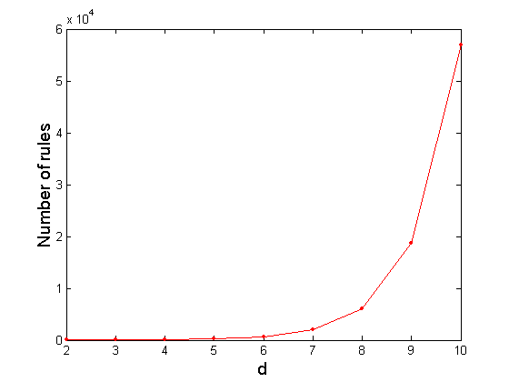
Computational Complexity
Given d unique items:
Total number of itemsets = 2^{d}
Total number of possible association rules:
If d=6, R = 602 rules

Slide 5
Mining Association Rules
Example of Rules:
{Milk,Diaper} → {Beer} (s=0.4, c=0.67) {Milk,Beer} → {Diaper} (s=0.4, c=1.0)
{Diaper,Beer} → {Milk} (s=0.4, c=0.67)
{Beer} → {Milk,Diaper} (s=0.4, c=0.67) {Diaper} → {Milk,Beer} (s=0.4, c=0.5)
{Milk} → {Diaper,Beer} (s=0.4, c=0.5)
Observations:
All the above rules are binary partitions of the same itemset: {Milk, Diaper, Beer}
Rules originating from the same itemset have identical support but can have different confidence
Thus, we may decouple the support and confidence requirements

Slide 6
Mining Association Rules
Two-step approach:
Frequent Itemset Generation
Generate all itemsets whose support ≥ minsup
Rule Generation
Generate high confidence rules from each frequent itemset, where each rule is a binary partitioning of a frequent itemset
Frequent itemset generation is still computationally expensive

Slide 7
Frequent Itemset Generation
Given d items, there are 2^{d} -1 possible candidate itemsets

Slide 8
Reducing Number of Candidates
Apriori principle:
If an itemset is frequent, then all of its subsets must also be frequent
Apriori principle holds due to the following property of the support measure:
Support of an itemset never exceeds the support of its subsets
This is known as the anti-monotone property of support

Slide 9
FI/Apriori Property
null
A
B
C
D
E
AB
AC
AD
AE
BC
BD
BE
CD
CE
DE
ABC
ABD
ABE
ACD
ACE
ADE
BCD
BCE
BDE
CDE
Frequent Itemset
ABCD
ABCE
ABDE
ACDE
BCDE
ABCDE

Slide 10
Anti-monotonicity Property
Found to be Infrequent
Pruned supersets

Slide 11
Illustrating Apriori Principle
Items (1-itemsets)
Pairs (2-itemsets)
(No need to generate candidates involving Coke or Eggs)
Minimum Support = 3
Triplets (3-itemsets)
If every subset is considered,
⁶C₁ + ⁶C₂ + ⁶C₃ = 41
With support-based pruning,
6 + 6 + 1 = 13

Slide 12
Apriori Algorithm -Example
L₁
C₁
Scan D
C₂
C₂
L₂
Scan D
C₃
Scan D
L₃

Slide 13
Apriori Algorithm
Method:
Let k=1
Generate frequent itemsets of length 1
Repeat until no new frequent itemsets are identified
Generate length (k+1) candidate itemsets from length k frequent itemsets
Prune candidate itemsets containing subsets of length k that are infrequent
Count the support of each candidate by scanning the DB
Eliminate candidates that are infrequent, leaving only those that are frequent

Slide 14
The Apriori algorithm
C_{k}: Candidate itemsets of size k
L_{k} : frequent itemsets of size k
L₁ = {frequent items};
for (k = 1; L_{k} !=∅; k++)
C_{k+1} = GenerateCandidates(L_{k})‏
for each transaction t in database do
increment count of candidates in C_{k+1} that are contained in t
endfor
L_{k+1} = candidates in C_{k+1} with support ≥min_sup
endfor
return ∪_{k} L_{k};

Slide 15
Apriori Algorithm
2-Step Process
Join Step (candidate generation)
Guarantees that no candidate of length > k is generated using L_{k-1}
Prune Step
Prunes those candidate itemsets all of whose subsets are not frequent

Slide 16
Apriori Algorithm
How to generate candidates?
Step 1: self-joining L_{k}
Step 2: pruning
How to count supports of candidates?
Example of Candidate-generation
L3={abc, abd, acd, ace, bcd}
Self-joining: L3*L3
abcd from abc and abd
acde from acd and ace
Pruning:
acde is removed because ade is not in L3
C4={abcd}

Slide 17
How to Generate Candidates?
Suppose the items in L_{k-1} are listed in an order
Step 1: self-joining L_{k-1}
insert into C_{k}
select p.item₁, p.item₂, …, p.item_{k-1}, q.item_{k-1}
from L_{k-1} p, L_{k-1} q
where p.item₁=q.item₁, …, p.item_{k-2}=q.item_{k-2}, p.item_{k-1} < q.item_{k-1}
Step 2: pruning
forall itemsets c in C_{k} do
forall (k-1)-subsets s of c do
if (s is not in L_{k-1}) then delete c from C_{k}

Slide 18
Exercise

Slide 19
Frequent Itemset Generation
Brute-force approach:
Each itemset in the lattice is a candidate frequent itemset
Count the support of each candidate by scanning the database
Match each transaction against every candidate
Complexity ~ O(NMw) => Expensive since M = 2^{d} !!!

Slide 20
Frequent Itemset Generation Strategies
Reduce the number of candidates (M)
Complete search: M=2^{d} - 1
Use pruning techniques to reduce M
Reduce the number of transactions (N)
Reduce size of N as the size of itemset increases
Used by DHP and vertical-based mining algorithms
Reduce the number of comparisons (NM)
Use efficient data structures to store the candidates or transactions
No need to match every candidate against every transaction

Slide 24
Support Counting
Compare each tx. against every candidate itemset & update the support count of candidates contained in the tx.
Computationally expensive when no. of txs. & no. of candidates is large
How to make it efficient?
Enumerate all itemsets contained in a tx. & use them to update support counts of their respective CIs
T1 has {1,2,3,5,6}. ⁵C₃ = 10 itemsets of size 3. some of these 10 will correspond to C₃. Others are ignored.
How to make matching operation efficient?
Use HASH TREE!!!

Slide 25
Subset Operation
Given a transaction t, what are the possible subsets of size 3?

Slide 26
How to Count Supports of Candidates?
Method:
Candidate itemsets are stored in a hash-tree
Leaf node of hash-tree contains a list of itemsets and counts
Interior node contains a hash table
Subset function: finds all the candidates contained in a transaction
Notes:
26

Slide 27
Reducing Number of Comparisons
Candidate counting:
Scan the database of transactions to determine the support of each candidate itemset
To reduce the number of comparisons, store the candidates in a hash structure
Instead of matching each transaction against every candidate, match it against candidates contained in the hashed buckets

Slide 28
Hash Tree
Partition CIs into different buckets and store them in hash tree
During support counting, itemsets in each tx. are also hashed into their appropriate buckets using the same hash function
for C₂

Slide 29
Hash Tree
Example: 3-itemset
All candidate 3-itemsets are hashed
Enumerate all the 3-itemsets of the tx.
All 3-itemsets contained in a transaction are also hashed
Comparison of a 3-itemset of tx. with all candidate 3-itemsets is avoided
Comparison is required to be done only in the appropriate bucket
Saves time ☺

Slide 30
Generate Hash Tree
Suppose you have 15 candidate itemsets of length 3:
{1 4 5}, {1 2 4}, {4 5 7}, {1 2 5}, {4 5 8}, {1 5 9}, {1 3 6}, {2 3 4}, {5 6 7}, {3 4 5}, {3 5 6}, {3 5 7}, {6 8 9}, {3 6 7}, {3 6 8}
You need:
Hash function: For each internal node use hash fn. h(p) = p mod 3
All candidate itemsets are stored at the leaf nodes of the hash tree
Max leaf size: max number of itemsets stored in a leaf node (if number of candidate itemsets exceeds max leaf size, split the node)
Hash function
2 3 4
5 6 7
3,6,9
1,4,7
1 4 5
3 4 5
3 5 6
3 5 7
6 8 9
3 6 7
3 6 8
1 3 6
2,5,8
1 2 4
4 5 7
1 2 5
4 5 8
1 5 9

Slide 31
Example of the hash-tree for C₃
Hash function: mod 3
H
H
Hash on 1st item
1,4,..
2,5,..
3,6,..
H
234
567
H
Hash on 2nd item
145
H
345
356
689
367
368
Hash on 3rd item
124
457
125
458
159
Notes:
31

Slide 32
Example of the hash-tree for C₃
2345
look for 2XX
345
look for 3XX
Hash function: mod 3
12345
H
H
Hash on 1st item
12345
look for 1XX
1,4,..
2,5,..
3,6,..
H
234
567
H
Hash on 2nd item
145
H
345
356
689
367
368
Hash on 3rd item
124
457
125
458
159
Notes:
32

Slide 33
Example of the hash-tree for C₃
2345
look for 2XX
345
look for 3XX
Hash function: mod 3
12345
H
H
Hash on 1st item
12345
look for 1XX
1,4,..
2,5,..
3,6,..
H
234
567
H
Hash on 2nd item
12345
look for 12X
∅
145
H
345
356
689
367
368
12345
look for 13X (null)‏
124
457
125
458
159
12345
look for 14X
The subset function finds all the candidates contained in a transaction:
At the root level it hashes on all items in the transaction
At level i it hashes on all items in the transaction that come after item the i-th item
Notes:
33

Slide 34
Association Rule Discovery: Hash tree
Hash Function
Candidate Hash Tree
1,4,7
3,6,9
2,5,8
2 3 4
5 6 7
1 4 5
1 3 6
3 4 5
3 5 6
3 6 7
Hash on 1, 4 or 7
3 5 7
3 6 8
1 2 4
1 5 9
6 8 9
1 2 5
4 5 7
4 5 8

Slide 35
Association Rule Discovery: Hash tree
Hash Function
Candidate Hash Tree
1,4,7
3,6,9
2,5,8
2 3 4
5 6 7
1 4 5
1 3 6
3 4 5
3 5 6
3 6 7
Hash on 2, 5 or 8
3 5 7
3 6 8
1 2 4
1 5 9
6 8 9
1 2 5
4 5 7
4 5 8

Slide 36
Association Rule Discovery: Hash tree
Hash Function
Candidate Hash Tree
1,4,7
3,6,9
2,5,8
2 3 4
5 6 7
1 4 5
1 3 6
3 4 5
3 5 6
3 6 7
Hash on 3, 6 or 9
3 5 7
3 6 8
1 2 4
1 5 9
6 8 9
1 2 5
4 5 7
4 5 8

Slide 37
Subset Operation Using Hash Tree
Hash Function
1 2 3 5 6
transaction
1,4,7
3,6,9
1 +
2 3 5 6
2,5,8
2 +
3 5 6
3 +
5 6
2 3 4
5 6 7
1 4 5
1 3 6
3 4 5
3 5 6
3 6 7
3 5 7
3 6 8
1 2 4
1 2 5
1 5 9
6 8 9
4 5 7
4 5 8

Slide 38
Subset Operation Using Hash Tree
1 2 3 5 6
transaction
Hash Function
1 +
2 3 5 6
2 +
3 5 6
1,4,7
3,6,9
1 2 +
3 5 6
3 +
5 6
2,5,8
1 3 +
5 6
2 3 4
1 5 +
6
5 6 7
1 4 5
1 3 6
3 4 5
3 5 6
3 6 7
3 5 7
3 6 8
1 2 4
1 2 5
1 5 9
6 8 9
4 5 7
4 5 8

Slide 39
Subset Operation Using Hash Tree
1 2 3 5 6
transaction
Hash Function
1 +
2 3 5 6
2 +
3 5 6
1,4,7
3,6,9
1 2 +
3 5 6
3 +
5 6
2,5,8
1 3 +
5 6
2 3 4
1 5 +
6
5 6 7
1 4 5
1 3 6
3 4 5
3 5 6
3 6 7
3 5 7
3 6 8
1 2 4
1 2 5
1 5 9
6 8 9
4 5 7
4 5 8
Match transaction against 11 out of 15 candidates

Slide 40
Factors Affecting Complexity
Choice of minimum support threshold
lowering support threshold results in more frequent itemsets
this may increase number of candidates and max length of frequent itemsets
Dimensionality (number of items) of the data set
more space is needed to store support count of each item
if number of frequent items also increases, both computation and I/O costs may also increase
Size of database
since Apriori makes multiple passes, run time of algorithm may increase with number of transactions
Average transaction width
transaction width increases with denser data sets
This may increase max length of frequent itemsets and traversals of hash tree (number of subsets in a transaction increases with its width)

Slide 41
Computational Complexity
Factors affecting computational complexity of Apriori:
Min_sup
No. of items (dimensionality)
No. of transactions
Average transaction width

Slide 42
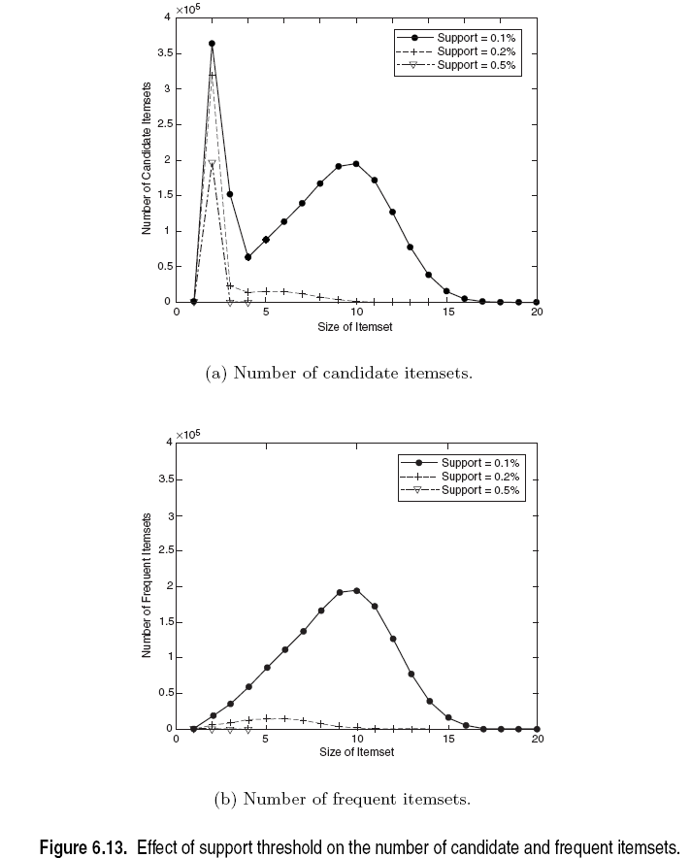

Slide 43
Computational Complexity
No. of items (dimensionality)
More space for storing support counts of items
If the no. of FIs grow with dim., the computation & I/O costs will increase because of the large no. of candidates generated by the algo.
No. of Transactions
Apriori makes repeated passes of the tr. DB
Run time increases as a result
Average Transaction width
Max. size of FIs increase as avg size of tx. Increases
More itemsets need to be examined during candidate generation and support counting
As width increases, more itemsets are contained in the tx. Will inc. the hash tree traversal

Slide 44
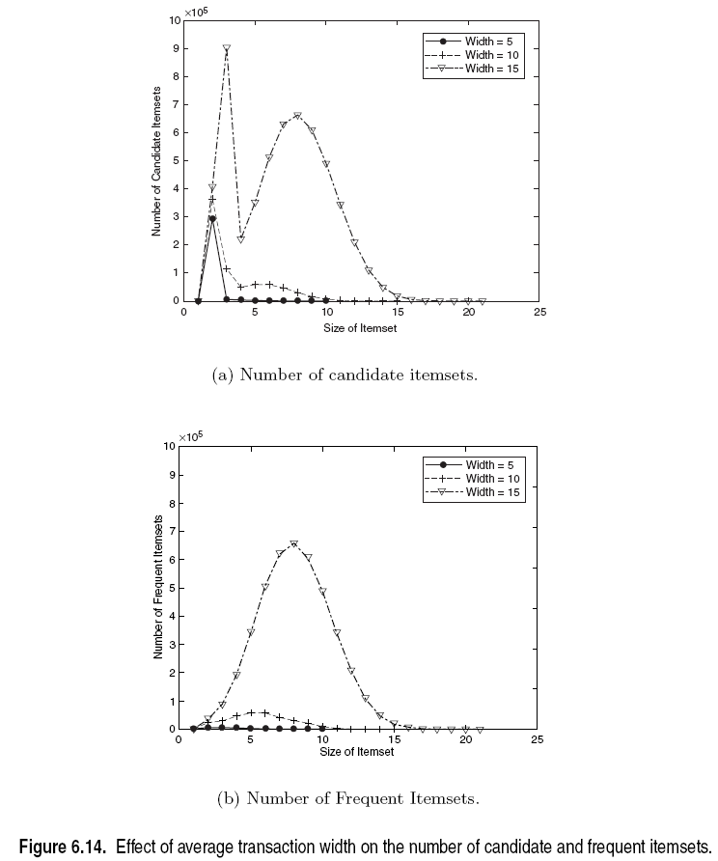

Slide 45
AR Generation from FIs
So far we have seen algorithms for finding FIs
Lets now look at how we can generate the ARs from FIs
FIs are concerned only with “support”
Time to bring in the concept of “confidence”
For each FI l, generate all non-empty subsets of l
For each non-empty subset s of l, output the rule
s → (l-s) if

Slide 46
AR Generation from FIs
For each k-FI, Y, we can have up to 2^{k}-2 ARs.
Ignore empty antecedents/consequents
Partition Y into 2 non-empty subsets X & Y-X, such that X→Y-X satisfies min_conf
We need not worry about min_sup!
Y={1,2,3}
6 candidate ARs: {1,2} →{3}, {1,3} →{2}, {2,3} →{1},
{1} →{2,3}, {2} →{1,3}, {3} →{1,2}
DO we need any additional scans to find confidence?
For {1,2} →{3}, the confidence is σ({1,2,3})/σ({1,2})
123 is frequent, therefore 12 is also frequent. So no need to find support counts again

